Slide 1
Comparative Analysis of Collar Strategy Performances Across Market Cycles
Academic Advisors: Dr. Tao Pang, Mr. Patrick Roberts
Project Leader: Nidhay Acharekar
Chuen Chun Michael Chan
Manoj Katravath
Sagar Prasad
Zhijiang Yang

Slide 2




Group Members
Chuen Chun Michael Chan
cchan8@ncsu.edu
Manoj Katravath
mkatrav@ncsu.edu
Sagar Prasad
sprasa23@ncsu.edu
Zhijiang Yang
zyang54@ncsu.edu

Slide 3
Our goal
Create different portfolios of options strategies and compare their performances across 2017-2019 (Pre Covid), 2019-2020 (Covid), 2020-2023 (Post Covid)
Portfolio construction methodology further explained later
Attempt to construct a portfolio that will be profitable in different market conditions: down trend, up trend, and range bound

Slide 4
Introduction to collar strategy
Risk Mitigation Strategy: Designed for investors holding stocks or other assets.
Components: Involves buying protective puts and selling covered calls.
Protective Puts: Guard against losses if asset prices fall.
Sold Calls: Generate income but limit potential gains if prices rise.
Balance: Aims to balance risk protection with profit potential.
Ideal for: Investors seeking to minimize significant losses while accepting capped gains.
Use in Volatile Markets: Effective in managing risks and protecting investments.

Slide 5
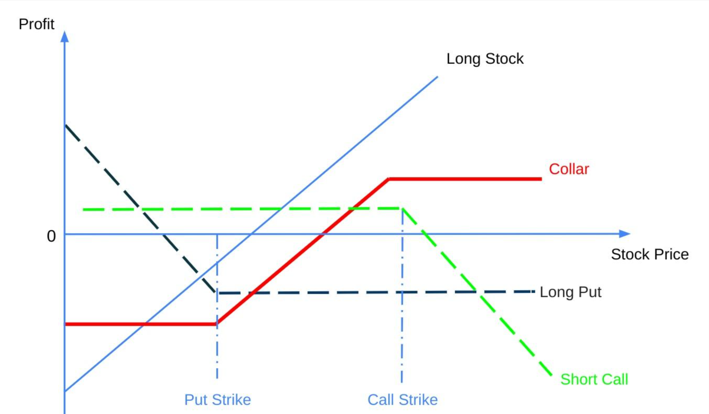
Introduction to collar strategy

Slide 6
Portfolio Construction
Naked long S&P 500
Portfolio with Call Moneyness = 3%, Put Moneyness = 5%
Portfolio with Call Moneyness = 5%, Put Moneyness = 3%
Portfolio with Call Moneyness = 3%, Put Moneyness = 7%
Portfolio with Call Moneyness = 5%, Put Moneyness = 1%
Monthly rebalancing
Because of this, the strike price of the options we buy each month will be different
Notes:
Why monthly rebalancing?

Slide 7
Reference Research Paper
Methods and Performances of Collar Strategies
Ilknur Tulunay, Anthony Hall, Nadima El-Hassan
University of Technology, Sydney, Australia
Constructing different collar portfolios and comparing their performances across 2008-2016
2008 after global financial crisis, excluding periods of extreme black swan event
Result comparison is slightly altered to account for lack of market data (too expensive)

Slide 8
Black-Scholes Model (BSM)
Mathematical formula to generate prices of European options given 5 different inputs
Spot price, Time to maturity, Strike, Volatility, and Risk-free rate
Volatility is assumed to be constant in BSM pricing, but in practice this is not realistic
After 1987 financial crash, volatility smile is observed in the market, leading to a breakdown of BSM constant vol. Assumption
Necessitate the need of a better vol. Measure: 10 day rolling window volatility

Slide 9
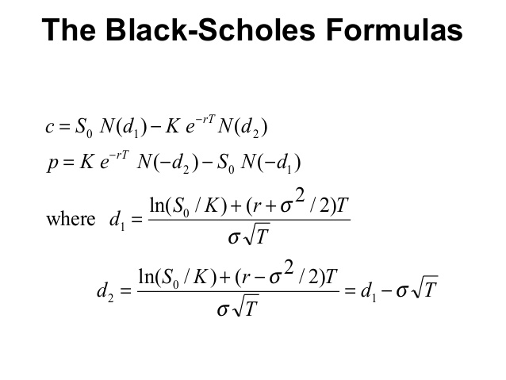
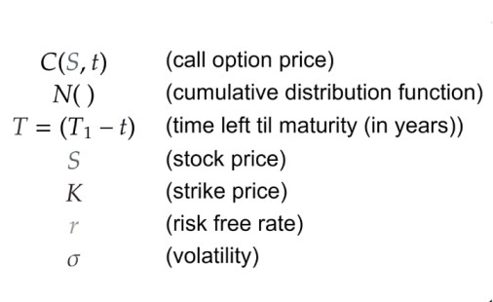
Black-Scholes Model (BSM)

Slide 10
Assumptions of BSM
Assumptions:
No dividends are paid out during the life of the option.
Markets are random (i.e., market movements cannot be predicted).
There are no transaction costs in buying the option.
The risk free rate and volatility of the underlying asset are known and constant.
The returns of the underlying asset are normally distributed.
The option is European and can only be exercised at expiration.

Slide 11
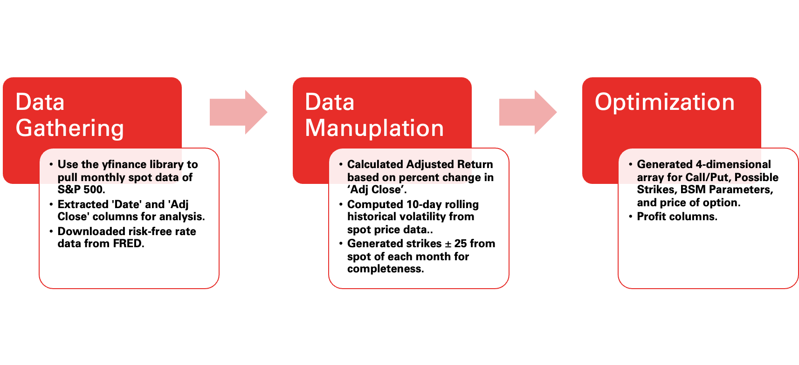
Data collection and cleaning

Slide 12
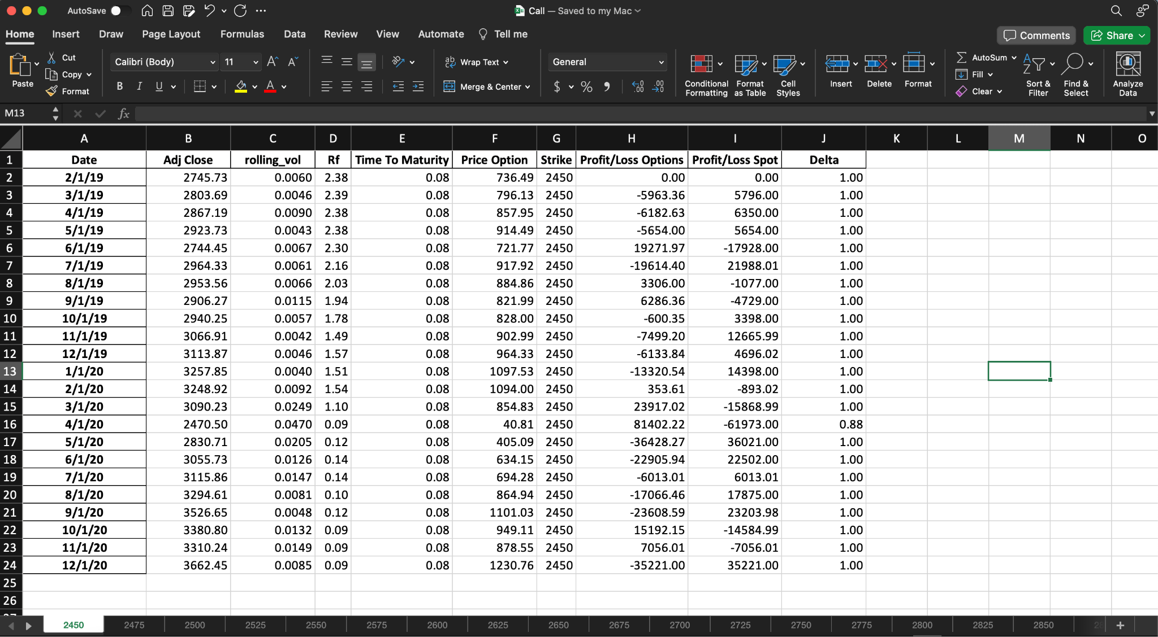
Data collection and cleaning
Dimension 1
Dimension 3 and Dimension 4
Dimension 2

Slide 13
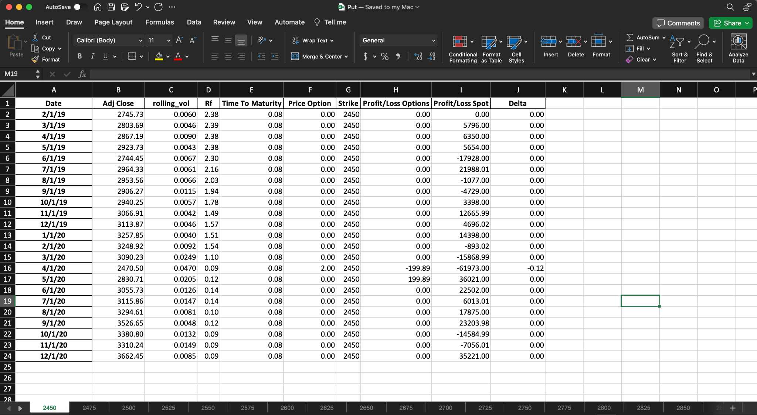
Data collection and cleaning
Dimension 1
Dimension 3 and Dimension 4
Dimension 2

Slide 14
Model Construction
BSM Function:
Takes parameters such as Risk-Free Rate, Strike, Call/Put Type, Adj Close, Rolling Volatility, and Time to Maturity.
Returns the calculated option price.
Profit Calculation Function:
Based on the BSM option price, calculates profit/loss for:
Buying 1 put
Shorting 1 call
Naked Spot Profit/Loss
Monthly Returns with Collar Strategy:
Utilizing various moneyness levels defined for our portfolio.
Calculates returns on a monthly basis(Re Balancing Period) using a collar strategy.
Comparison with Naked Call:
Compares the results of different portfolios with the naked call strategy.

Slide 15
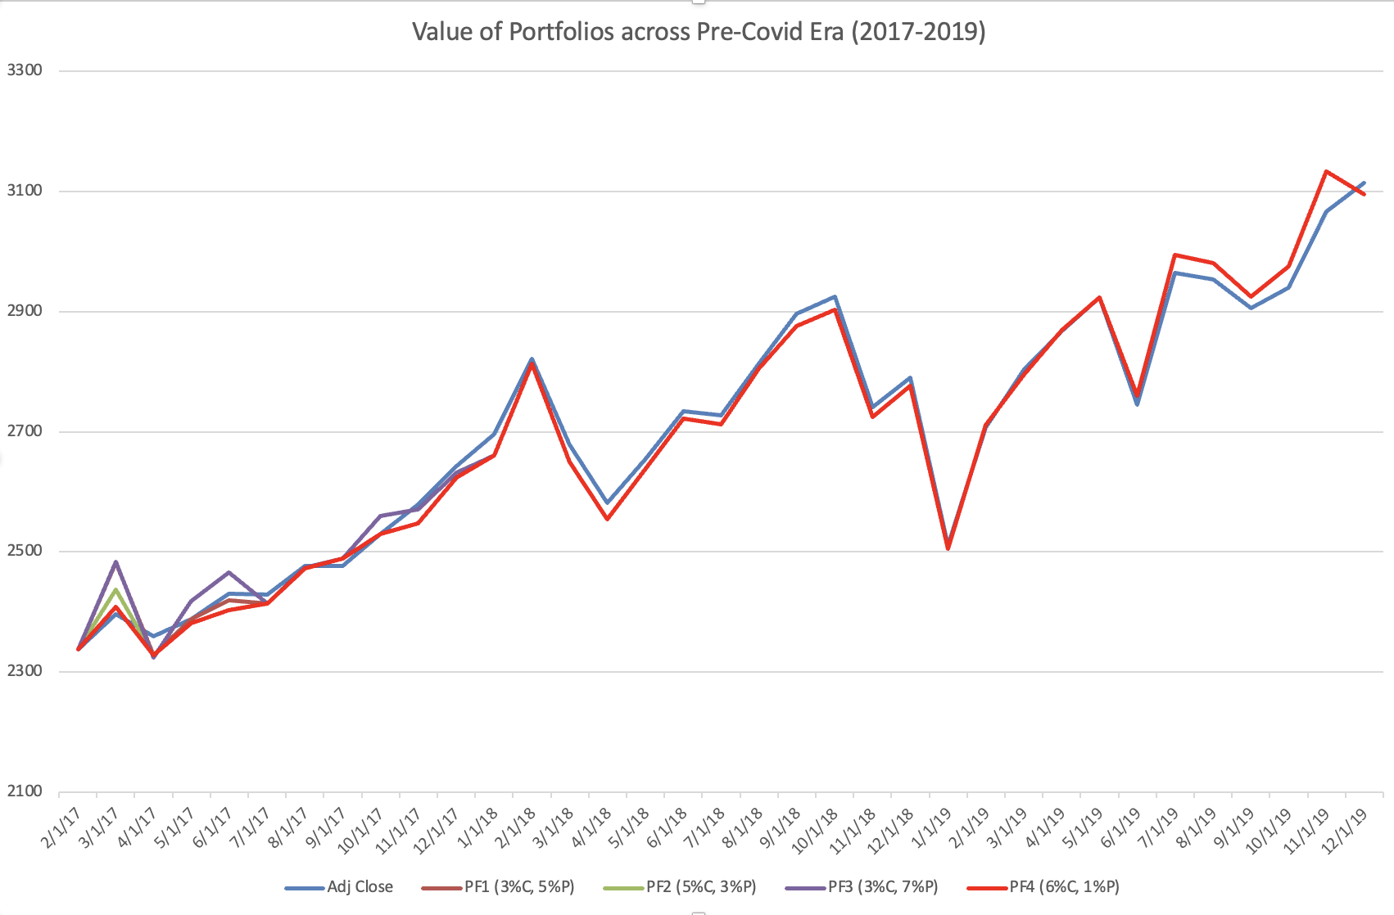
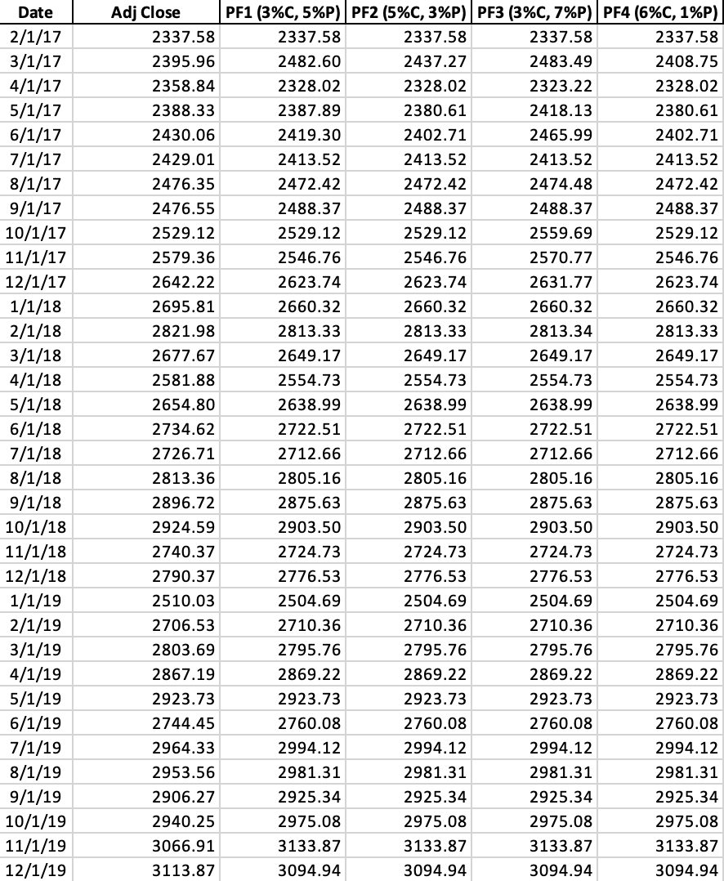

Portfolio Performances for 2017-2019 (Pre-Covid Era)

Slide 16
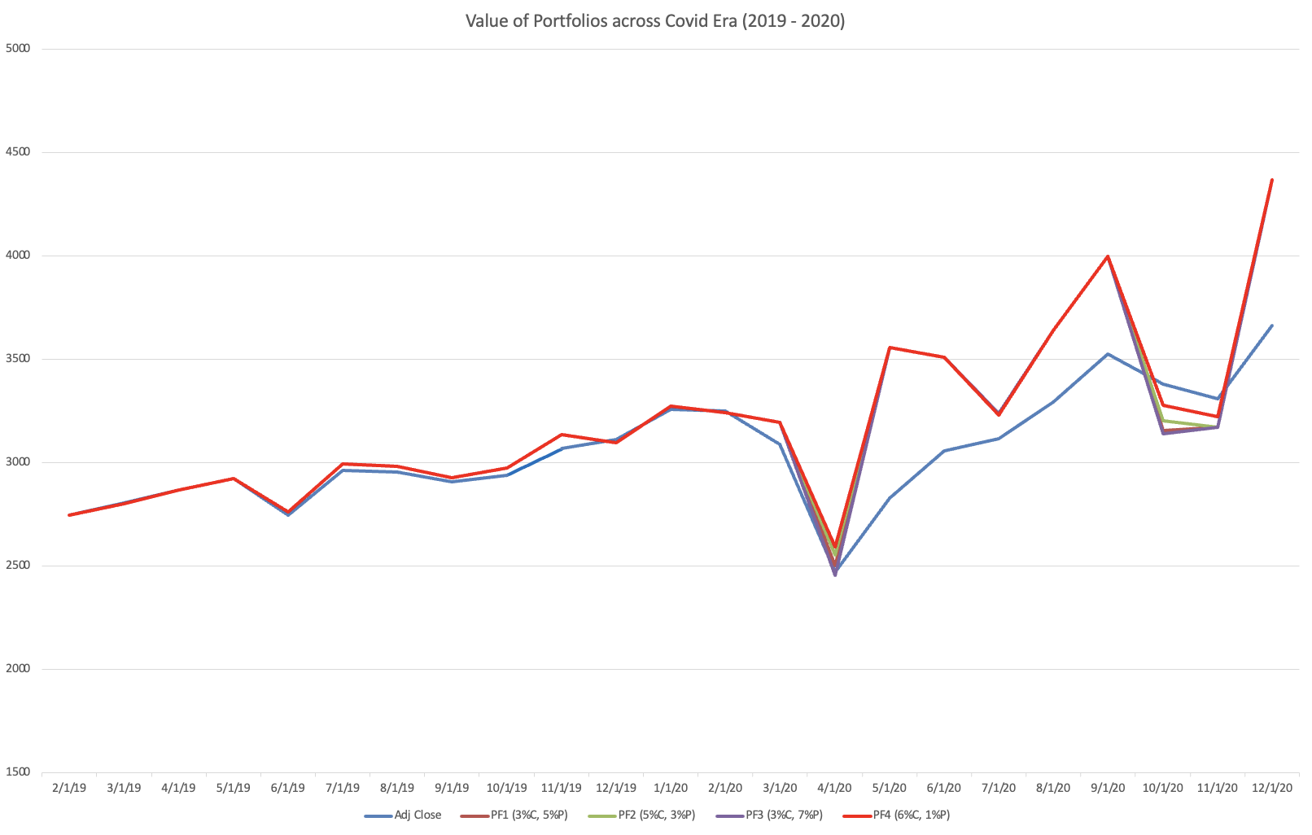
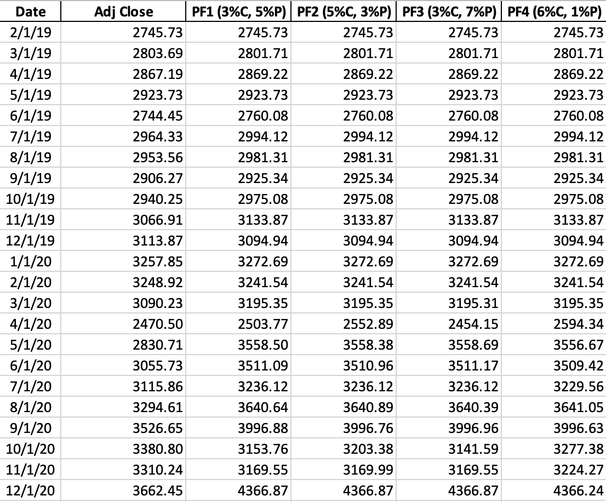

Portfolio Performances for 2019-2020 (Covid Era)

Slide 17
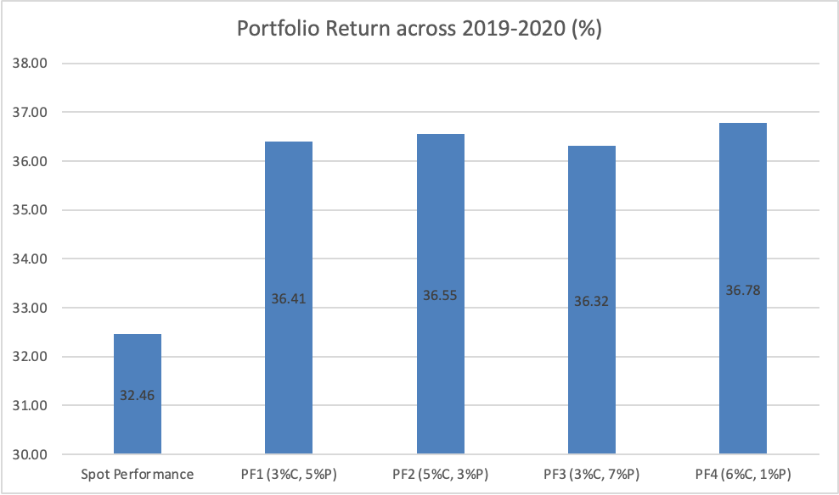
Portfolio Performances for 2019-2020 (Covid Era)

Slide 18
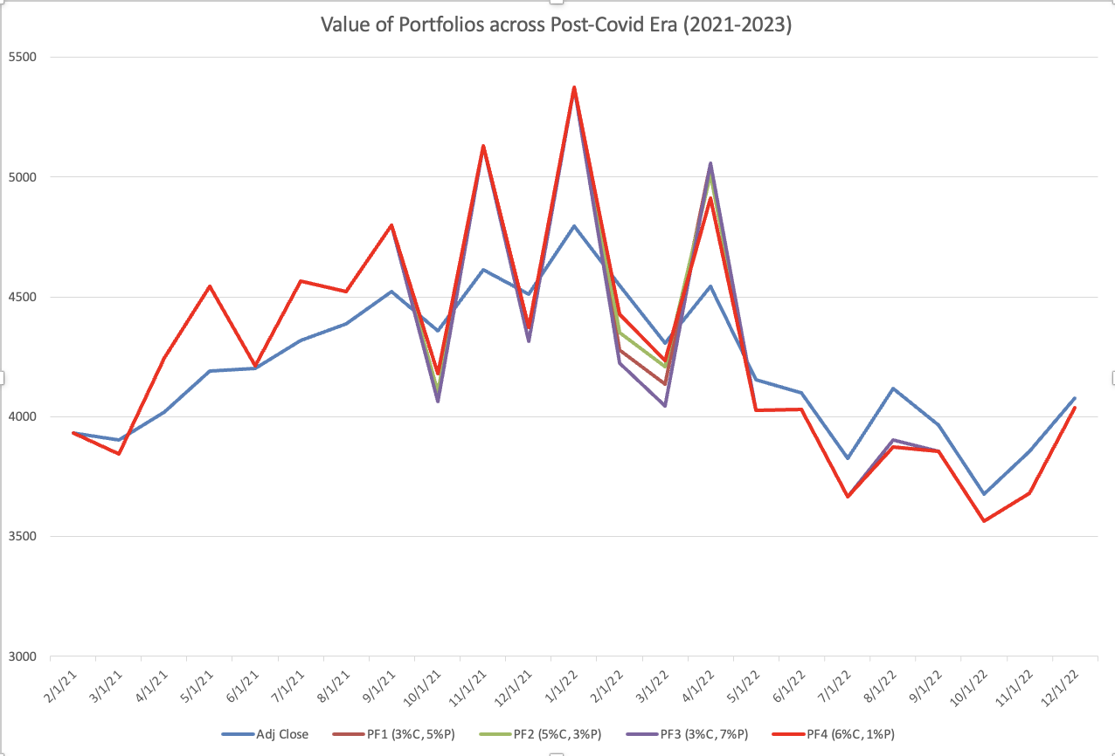
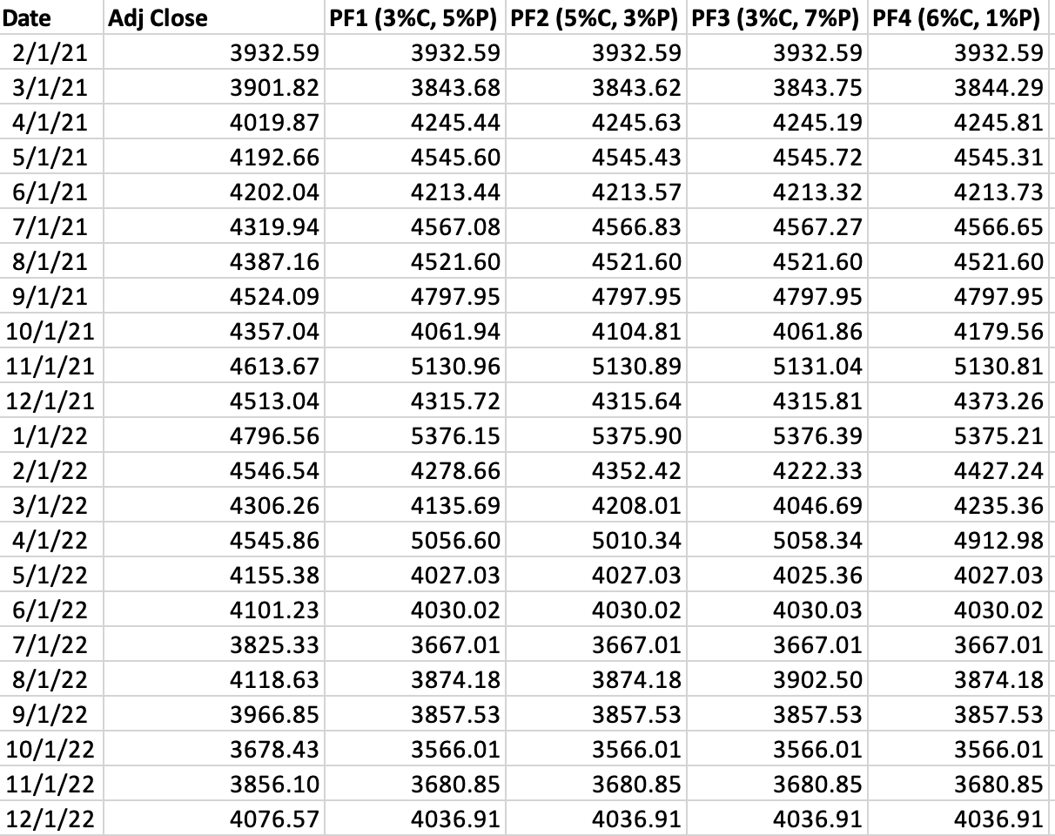

Portfolio Performances for 2020-2023 (Post-Covid Era)

Slide 19
Conclusion
Portfolios returns are very similar in stable market conditions
PF3 (3% Call, 7% Put) performed the best in Pre-Covid Era with 0.07% of excess returns
PF1 (3% Call, 5% Put) performed best in Post-Covid Era with 0.85% of excess returns
Need to factor in transaction cost from rebalancing in practice, reducing returns
PF4 (6% Call, 1% Put) performed the best during Covid times generating 4.31% excess returns
Surprising considering a higher OTM % Call write should decrease the delta of the collar leading to less profits in bull market; providing more downside protection

Slide 20
Future Work
Create zero-cost collar and active collar strategies to compare with current static ones
Use market options implied volatility data for more accurate price input into BSM
Compare collar performances for illiquid stocks and compare the effect of liquidity on portfolio performance

Slide 21
Q & A
Thank you!
Chuen Chun Michael Chan
cchan8@ncsu.edu
Manoj Katravath
mkatrav@ncsu.edu
Sagar Prasad
sprasa23@ncsu.edu
Zhijiang Yang
zyang54@ncsu.edu

